Slide 1
An Android Application for Keeping Up with the Latest Headlines
S.Mohamed Suhail
NM ID:aut8121cs9
Reg No:812122104025

Slide 2
Description
The android application serves as A dynamic hub for staying updated with the latest headlines, offering A seamless and intuitive user experience. It curates news from diverse sources across categories such as politics, technology, sports, entertainment, and more, ensuring users never miss A beat. With A sleek and user-friendly interface, the app allows quick navigation, personalized news preferences, and real-time updates. A search feature enables users to find articles on specific topics, while push notifications ensure timely alerts for breaking news. The app supports multimedia content, including videos and images, for an immersive reading experience. Users can save articles for offline reading, share stories on social media, and engage with interactive polls and comments. Advanced filters, like region-specific news and trending topics, make the experience highly customizable. With A focus on reliability and speed, this app is the perfect companion for staying informed in A fast-paced world.

Slide 3
Technologies
1. Programming Languages
Kotlin: The preferred language for Android development due to its modern syntax, null safety, and interoperability with Java.
Java: A long-standing language for Android, known for its stability and extensive community support.
2. Android Development Tools
Android Studio: The official Integrated Development Environment (IDE) for Android, offering a rich set of tools like code editing, debugging, and layout design.
Gradle: A build automation tool used for managing project dependencies and compiling code.
3. Backend and Networking
RESTful APIs or GraphQL APIs: For connecting the app to backend services and fetching dynamic data.
Retrofit, Volley, or OkHttp: Libraries for handling network requests and API integration.

Slide 4
MainActivity.kt
package com.example.newsheadlines
import android.content.Context
import android.content.Intent
import android.content.Intent.FLAG_ACTIVITY_NEW_TASK
import android.os.Bundle
import android.util.Log
import android.widget.TextView
import androidx.activity.ComponentActivity
import androidx.activity.compose.setContent
import androidx.activity.viewModels
import androidx.compose.foundation.Image
import androidx.compose.foundation.background
import androidx.compose.foundation.clickable
import androidx.compose.foundation.layout.*
import androidx.compose.foundation.lazy.LazyColumn
import androidx.compose.foundation.lazy.itemsIndexed
import androidx.compose.foundation.selection.selectable
import androidx.compose.foundation.shape.RoundedCornerShape
import androidx.compose.material.Card

Slide 5
import androidx.compose.material.MaterialTheme
import androidx.compose.material.Surface
import androidx.compose.material.Text
import androidx.compose.runtime.*
import androidx.compose.ui.Modifier
import androidx.compose.ui.graphics.Color
import androidx.compose.ui.text.font.FontWeight
import androidx.compose.ui.text.style.TextAlign
import androidx.compose.ui.unit.dp
import androidx.compose.ui.unit.sp
import androidx.compose.ui.viewinterop.AndroidView
import androidx.core.text.HtmlCompat
import coil.compose.rememberImagePainter
import coil.size.Scale
import coil.transform.CircleCropTransformation
import com.example.example.Articles
import com.example.newsheadlines.ui.theme.NewsHeadlinesTheme

Slide 6
class MainPage : ComponentActivity() {
val mainViewModel by viewModels<MainViewModel>()
override fun onCreate(savedInstanceState: Bundle?) {
super.onCreate(savedInstanceState)
setContent {
NewsHeadlinesTheme {
// A surface container using the 'background' color from the theme
Surface(color = MaterialTheme.colors.background) {
Column() {
Text(text = "Latest NEWS", fontSize = 32.sp, modifier = Modifier.fillMaxWidth(), textAlign = TextAlign.Center)
MovieList(applicationContext, movieList = mainViewModel.movieListResponse)
mainViewModel.getMovieList()
}
}
}
}
}
}

Slide 7
@Composable
fun MovieList(context: Context, movieList: List<Articles>) {
var selectedIndex by remember { mutableStateOf(-1) }
LazyColumn {
itemsIndexed(items = movieList) {
index, item ->
MovieItem(context,movie = item, index, selectedIndex) { i ->
selectedIndex = i
}
}
}
}
@Composable
fun MovieItem(context: Context) {
val movie = Articles(
"Coco",
"",
" articl"
)

Slide 8
MovieItem(context,movie = movie, 0, 0) { i ->
Log.i("wertytest123abc", "MovieItem: "
+i)
}
}
@Composable
fun MovieItem(context: Context, movie: Articles, index: Int, selectedIndex: Int,
onClick: (Int) -> Unit)
{
val backgroundColor = if (index == selectedIndex) MaterialTheme.colors.primary else MaterialTheme.colors.background
Card(
modifier = Modifier
.padding(8.dp, 4.dp)
.fillMaxSize()
.selectable(true, true, null,
onClick = {
Log.i("test123abc", "MovieItem: $index/n$selectedIndex")
})

Slide 9
.clickable { onClick(index) }
.height(180.dp), shape = RoundedCornerShape(8.dp), elevation = 4.dp
) {
Surface(color = Color.White) {
Row(
Modifier
.padding(4.dp)
.fillMaxSize()
)
{
Image(
painter = rememberImagePainter(
data = movie.urlToImage,
builder = {
scale(Scale.FILL)
placeholder(R.drawable.placeholder)
transformations(CircleCropTransformation())
}
),

Slide 10
contentDescription = movie.description,
modifier = Modifier
.fillMaxHeight()
.weight(0.3f)
)
Column(
verticalArrangement = Arrangement.Center,
modifier = Modifier
.padding(4.dp)
.fillMaxHeight()
.weight(0.8f)
.background(Color.Gray)
.padding(20.dp)
.selectable(true, true, null,
onClick = {
Log.i("test123abc", "MovieItem: $index/n${movie.description}")
context.startActivity(
Intent(context, DisplayNews::class.java)
.setFlags(Intent.FLAG_ACTIVITY_NEW_TASK)

Slide 11
.putExtra("desk", movie.description.toString())
.putExtra("urlToImage", movie.urlToImage)
.putExtra("title", movie.title)
)
})
) {
Text(
text = movie.title.toString(),
style = MaterialTheme.typography.subtitle1,
fontWeight = FontWeight.Bold
)
HtmlText(html = movie.description.toString())
}
}
}
}

Slide 12
@Composable
fun HtmlText(html: String, modifier: Modifier = Modifier) {
AndroidView(
modifier = modifier
.fillMaxSize()
.size(33.dp),
factory = { context -> TextView(context) },
update = { it.text = HtmlCompat.fromHtml(html, HtmlCompat.FROM_HTML_MODE_COMPACT) }
)
}
}

Slide 13
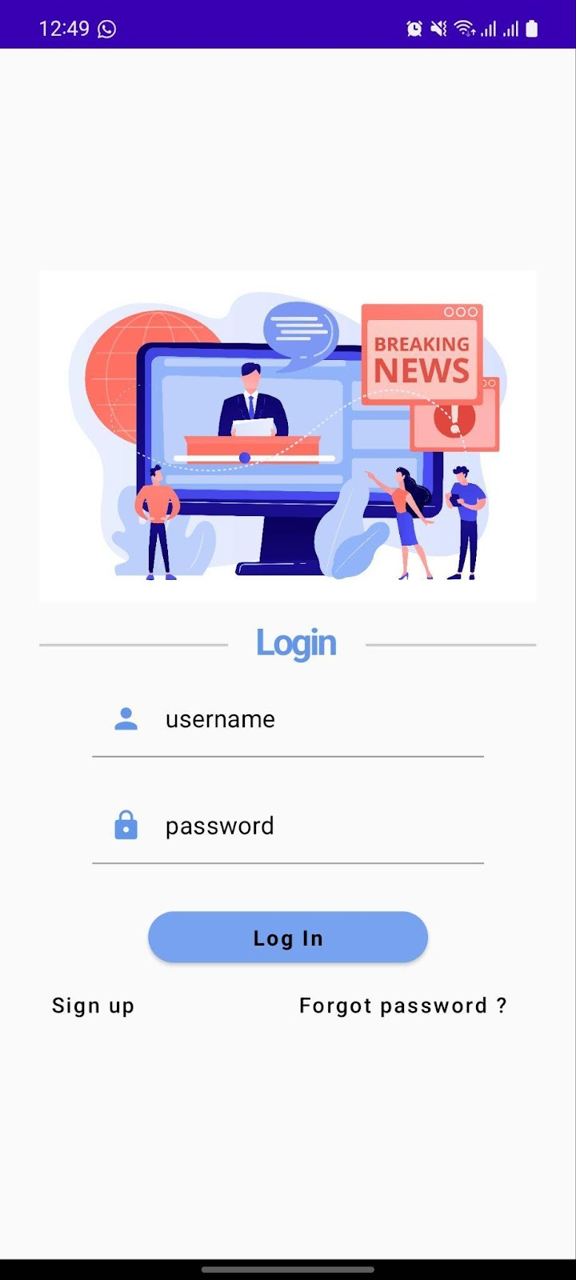
Output

Slide 14
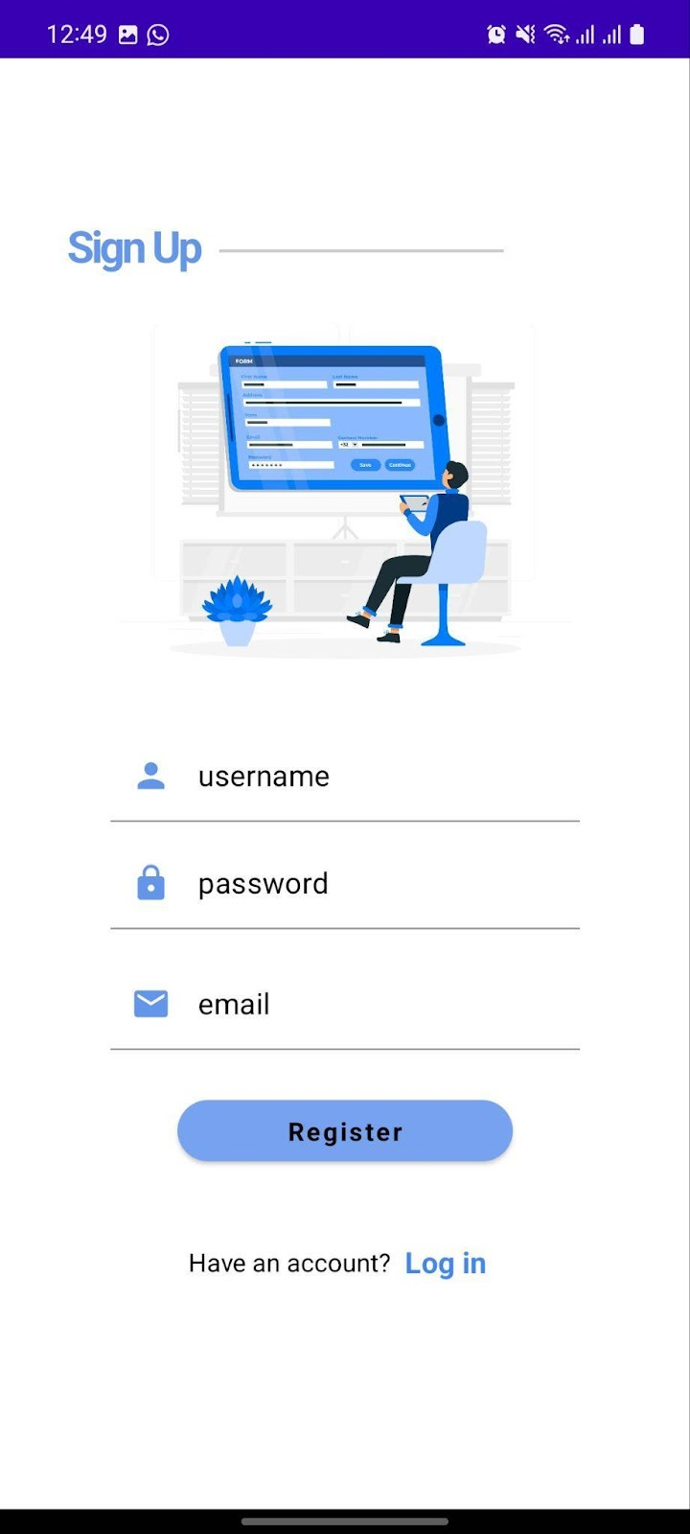

Slide 15
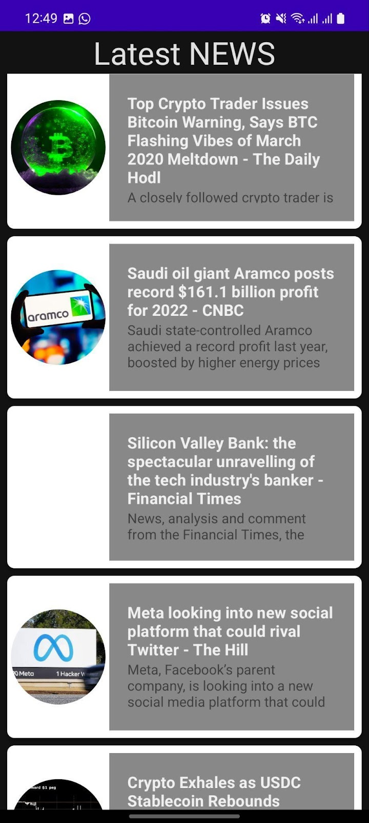

Slide 16


